Slide 1
Designing Effective Data Visualization

Slide 2
Outline
Introduction
Pre-attentive attributes
Color
Color Palettes
Sequential Palette
Qualitative Palette
Diverging Palette

Slide 3
Introduction
Data visualization relies on communication through perception. A good data visualization can exploit the natural tendency of the human visual system to recognize structure and patterns.

Slide 4
The brain can process information faster and more efficiently when it is in a visual format.

Slide 5
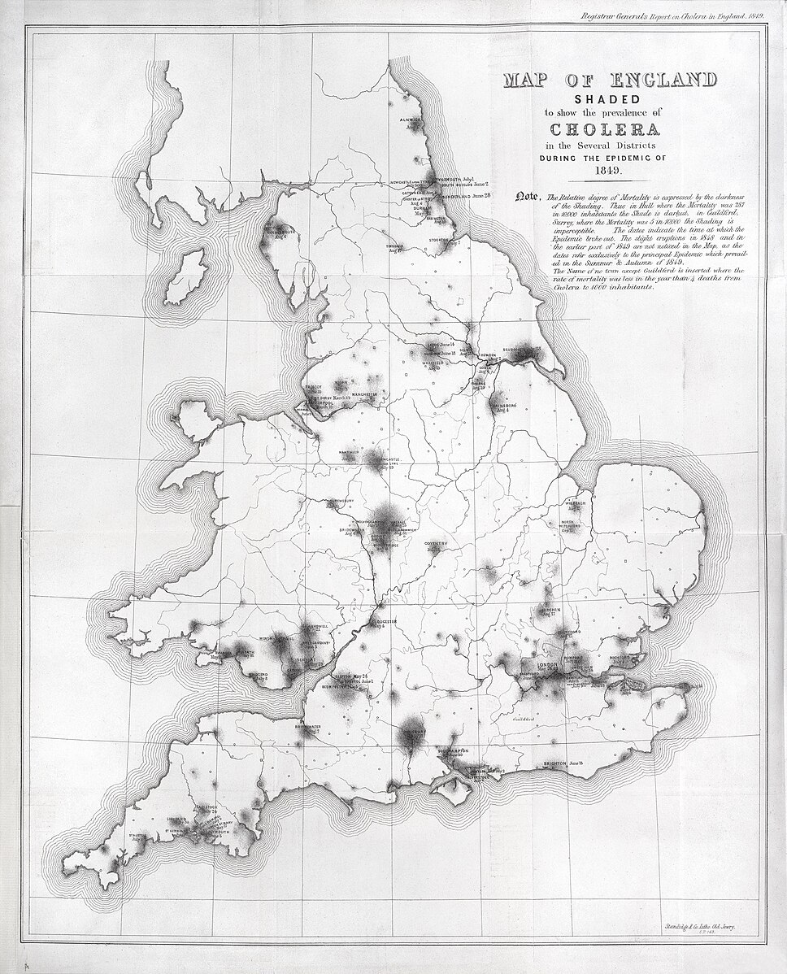

Slide 6
In 1854, a severe cholera outbreak occurred in Soho, London, England during the 1846-1860 cholera pandemic which killed 616 people

Slide 7
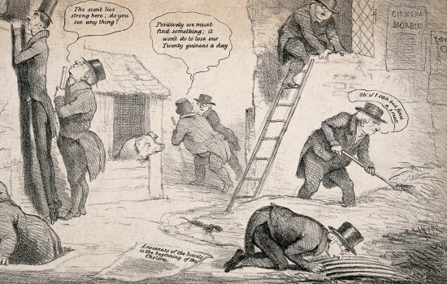
Many people believed that cholera was caused by miasma, meaning “bad air” arising from rotting organic matter, sewage which was called the miasma theory

Slide 8
The miasma theory:
Diseases like cholera were thought to spread through noxious vapors
Bad smells = bad health
Poor, dirty, overcrowded areas were seen as dangerous because of the air, not microbes

Slide 9
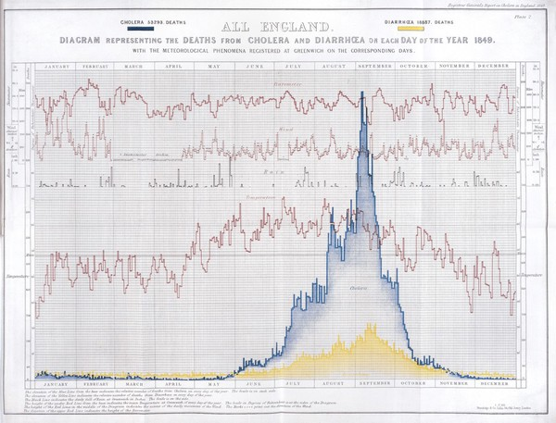

Slide 10
William Farr, one of the well known statisticians at that time, gathered data and supported this theory and observed that
Cholera peaked in the summer months
Mortality dropped sharply in winter
Outbreaks were worse during hot weather

Slide 11
So his interpretation was:
Heat intensified miasma
Warm temperatures were thought to accelerate decomposition of matter
This produced “bad air” which was assumed to cause cholera

Slide 12
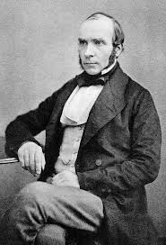
The turning point was when in 1854, a physician named John challenged the miasma theory. His approach was different
He mapped cholera cases in London that showed they clustered around the Broad Street water pump

Slide 13
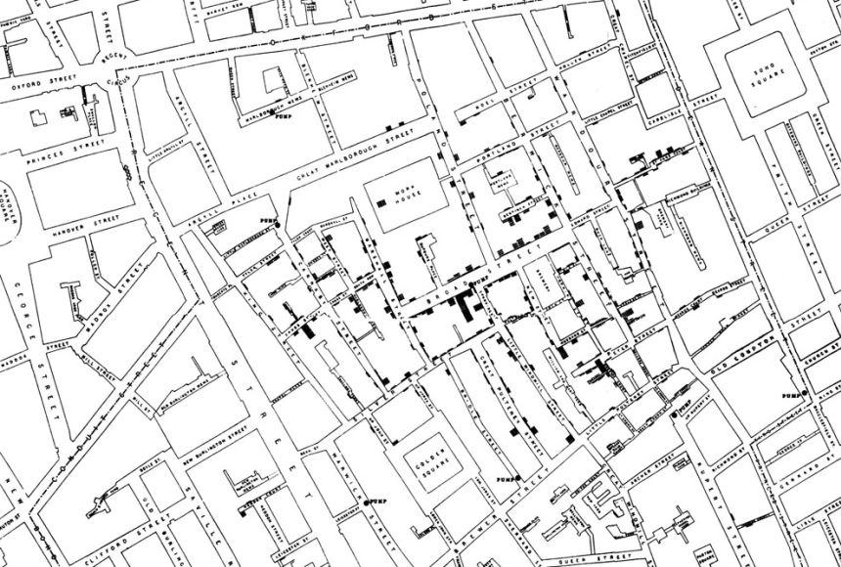

Slide 15
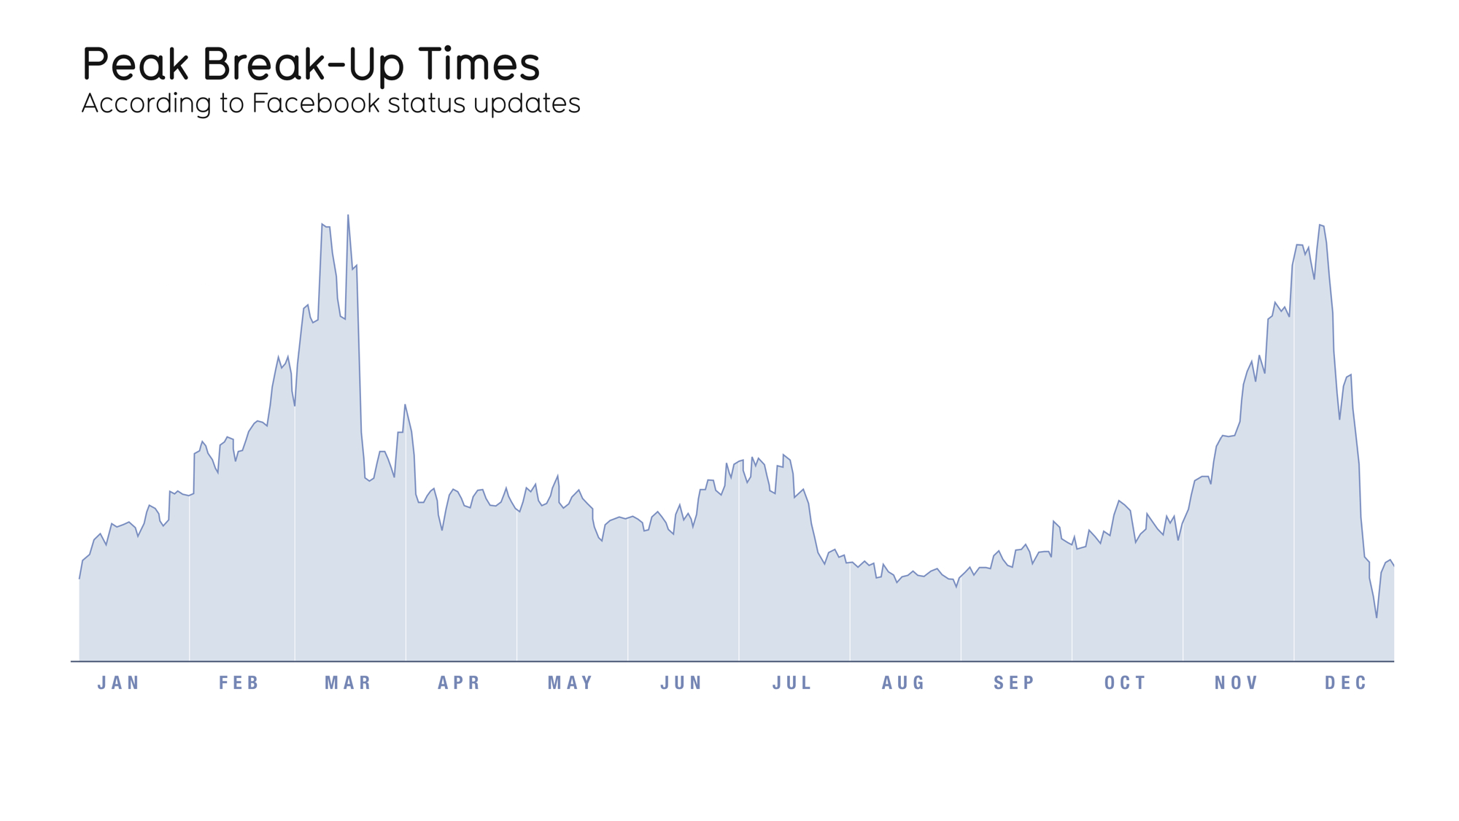

Slide 17
Introduction
They key to achieving effective visualization is to correspond your data to pre-attentive attributes. Preattentive attributes are visual attributes, including size, color, shape, and position that are processed at a high speed by the visual system.

Slide 18
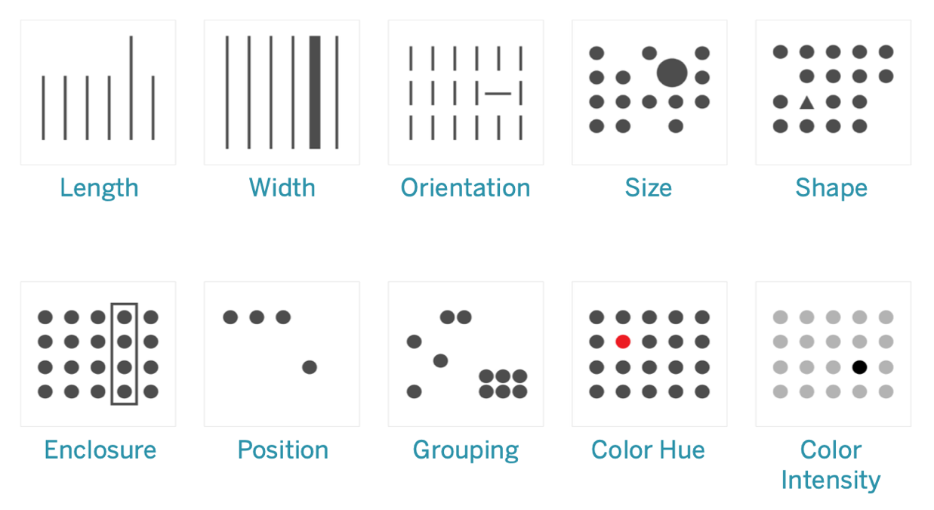
Pre-Attentive Attributes
Pre-attentive attributes are information we can process visually almost immediately, before sending the information to the attention processing parts of our brain.

Slide 19
What stands out to you in each image? Was the red dot in the color hue figure immediately apparent? That is pre-attentive processing at work.

Slide 20
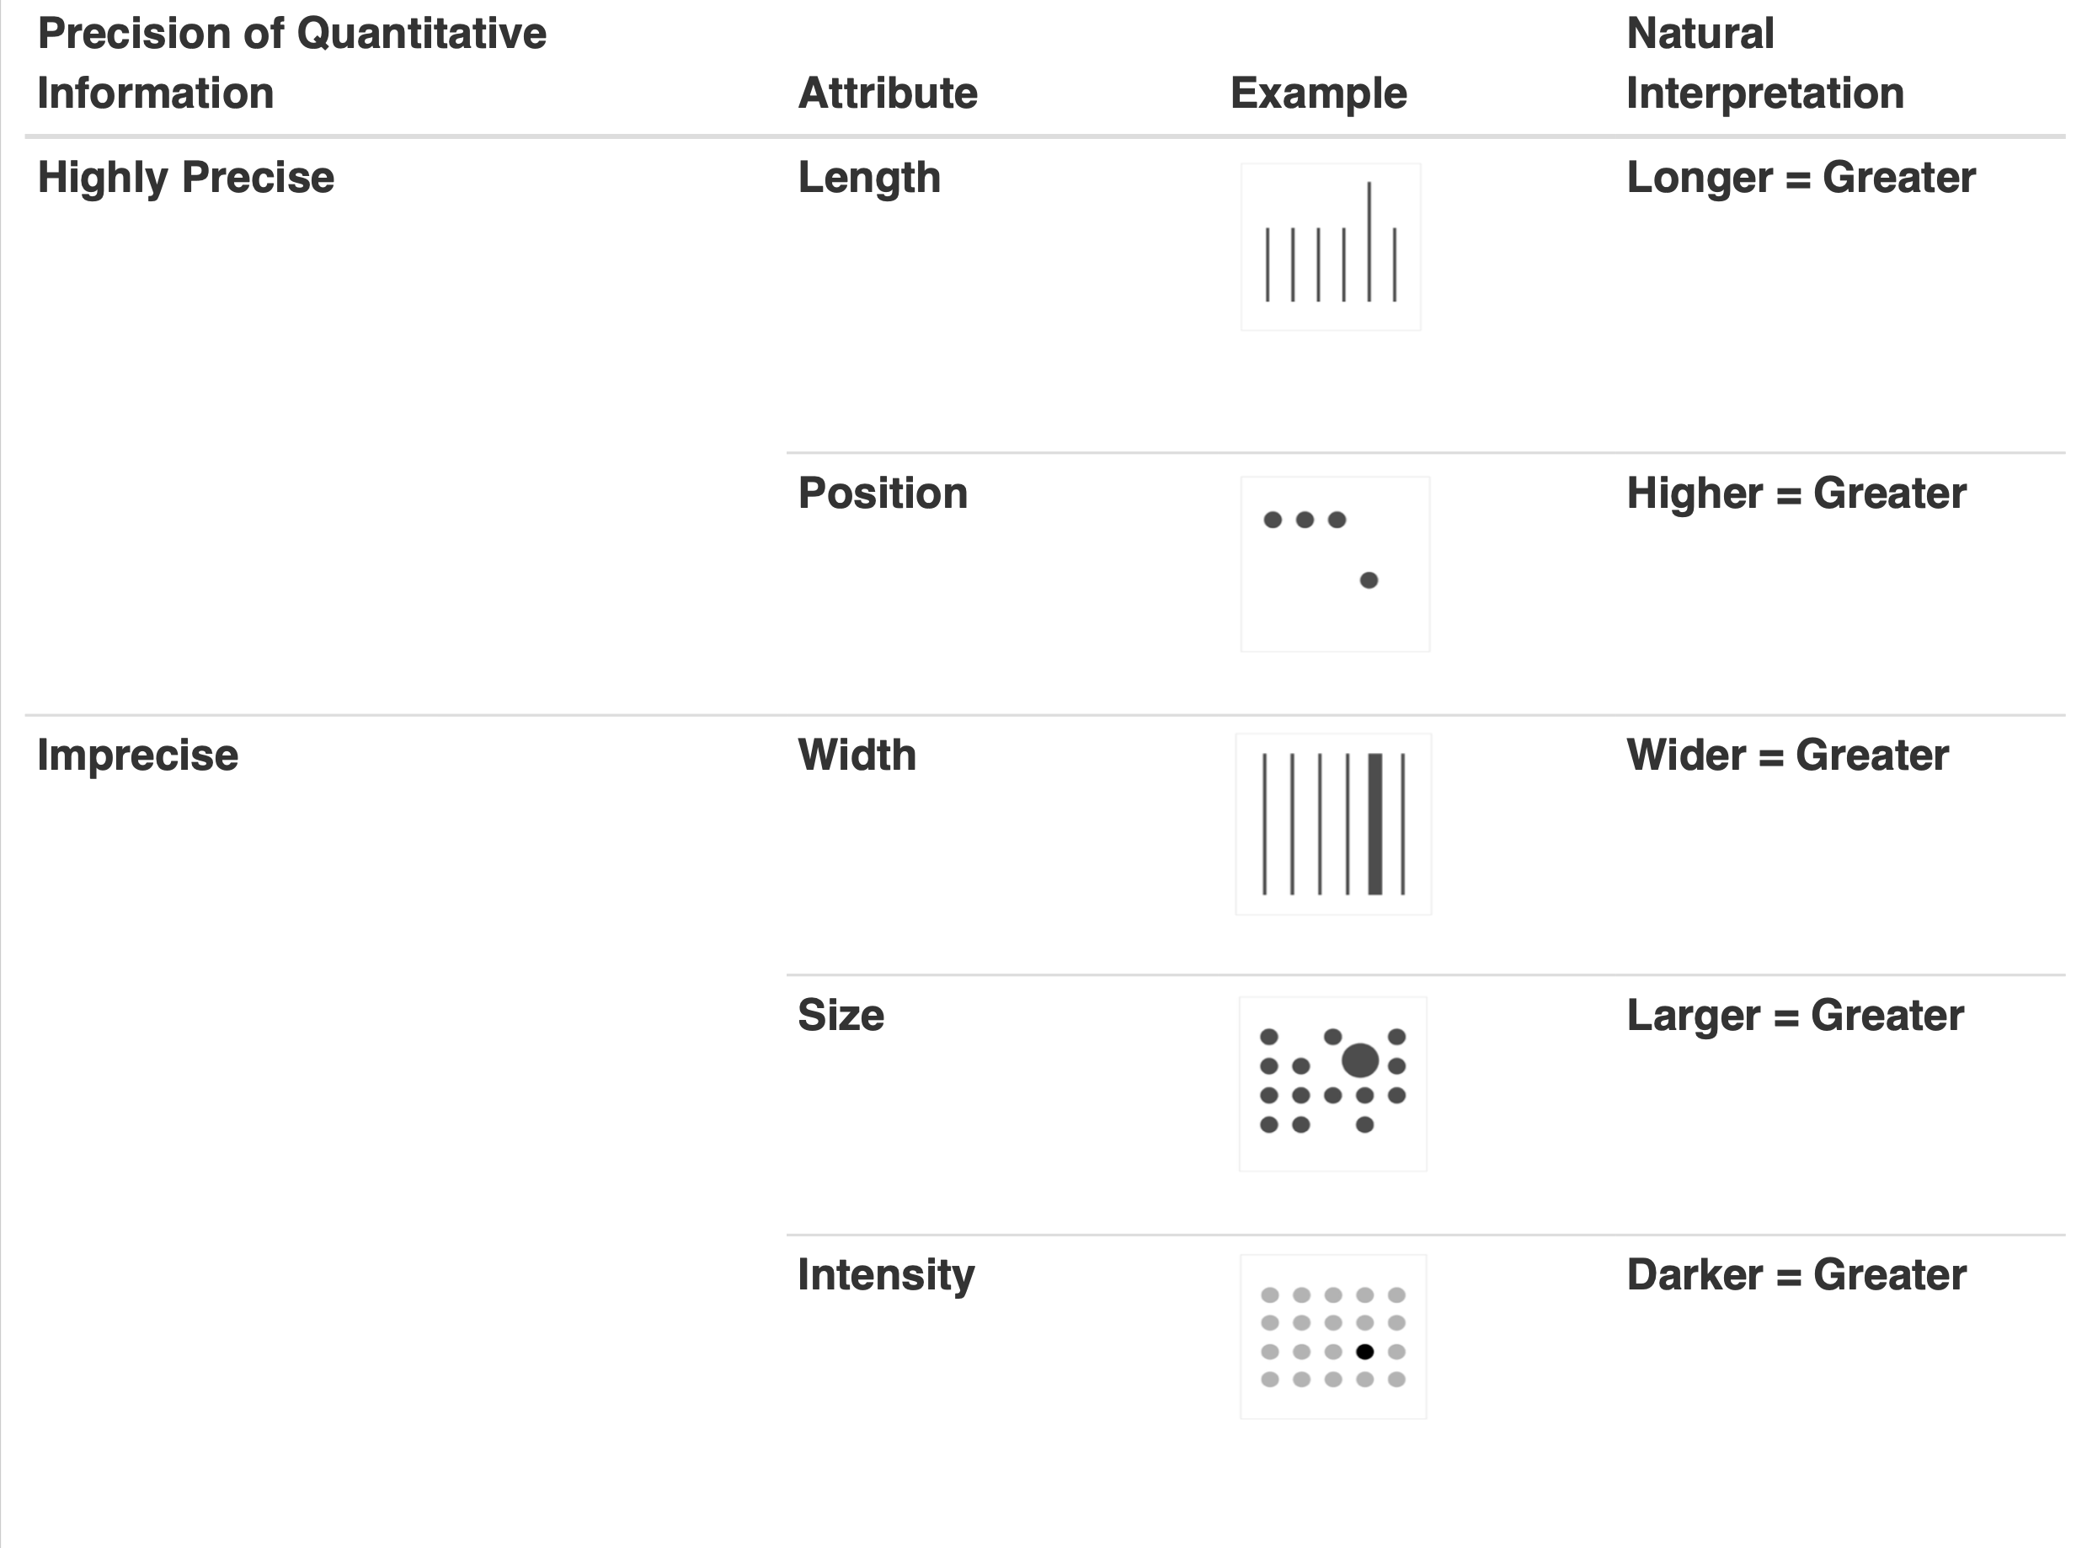

Slide 21
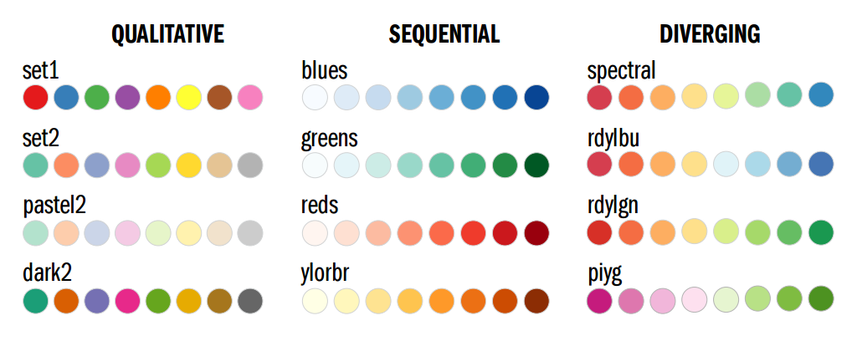
Color in Data Visualization
Colors play a pivotal role in shaping how we perceive and understand the information conveyed in your data visualization approach.

Slide 22
Color in Data Visualization
According to MIT neuroscientists, pre-attentive processing (PaP) takes approximately 13 milliseconds.
This process refers to how our eyes interpret images, colors, patterns, and shapes as information.
What does this mean for the role of color in data visualization? By carefully selecting a color palette, we embrace the power of PaP, making data easier to understand and find.
https://news.mit.edu/2014/in-the-blink-of-an-eye-0116

Slide 23
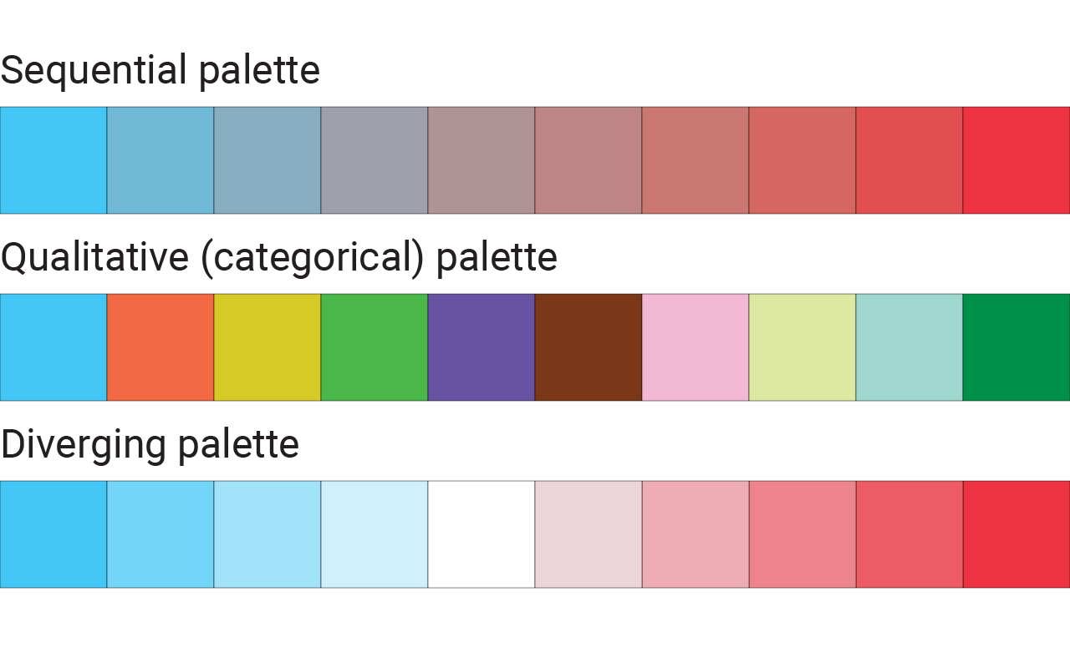
Color Palette

Slide 24
Color Palette
To effectively convey the information, it’s essential to have a clear understanding of how to use color in data visualization. In doing so, you must know the different color palette types and the significance of each one.

Slide 25
Sequential Palette
This palette is designed with discrete steps or a continuous gradient. This progression of hues is typically used in numerical representations like heat maps, pie charts, and other scales.

Slide 26
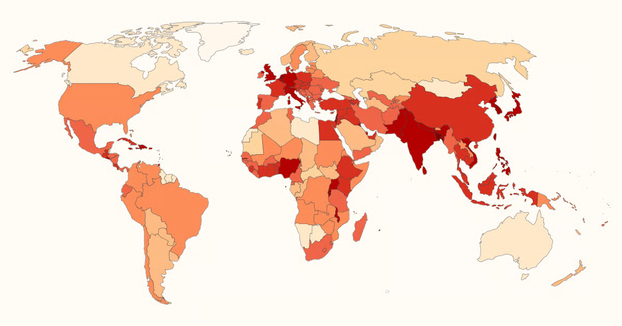
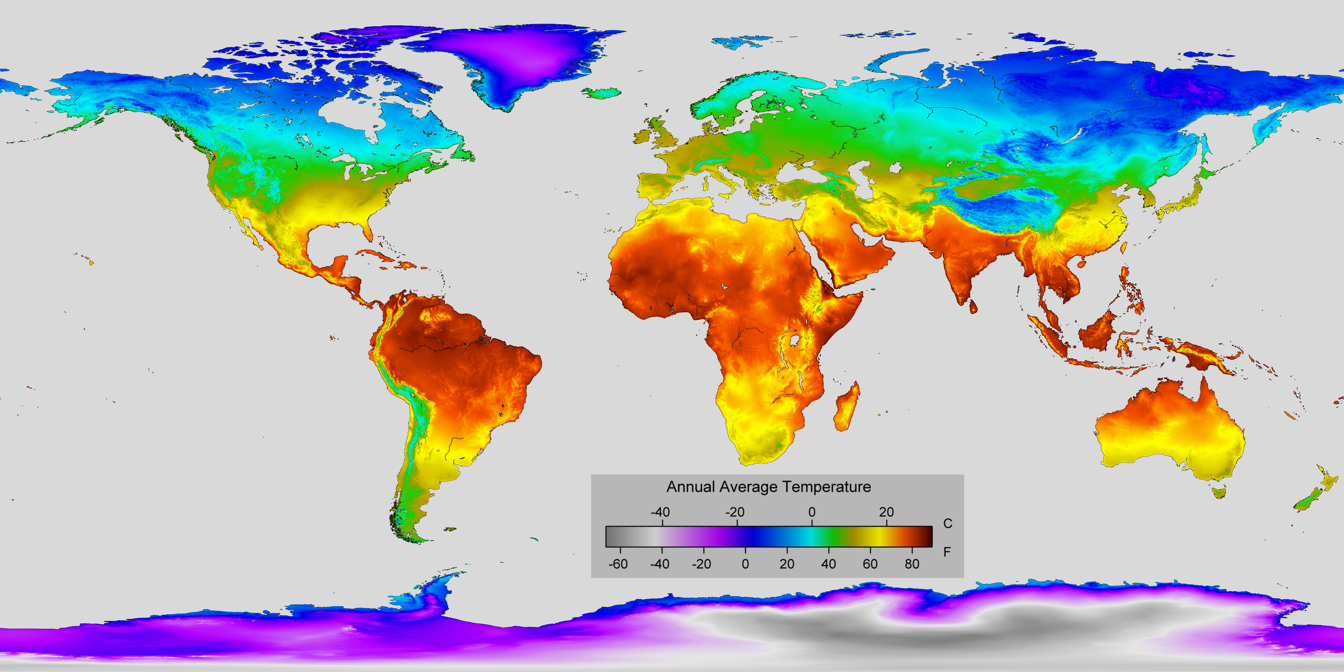
Sequential Palette
Using the sequential palette is useful when illustrating data with a clear hierarchy or progression. These graphs depict data like population density, temperature variations, and other kinds of sequential data. The palette helps to convey trends and patterns more effectively.

Slide 27
Using the sequential palette is useful when illustrating data with a clear hierarchy or progression. These graphs depict data like population density, temperature variations, and other kinds of sequential data. The palette helps to convey trends and patterns more effectively.

Slide 28
Using the sequential palette is useful when illustrating data with a clear hierarchy or progression. These graphs depict data like population density, temperature variations, and other kinds of sequential data. The palette helps to convey trends and patterns more effectively.

Slide 29
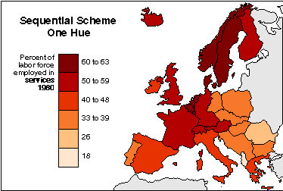
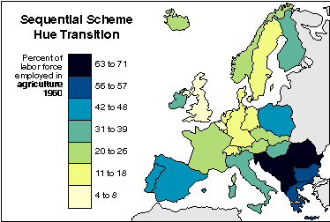

Slide 30
Qualitative palettes
Also known as categorical palettes, qualitative palettes are used when dealing with categorical variables. It represents data without an inherent order, like country or gender. Each category is assigned a distinct color to aid in visualization.

Slide 31
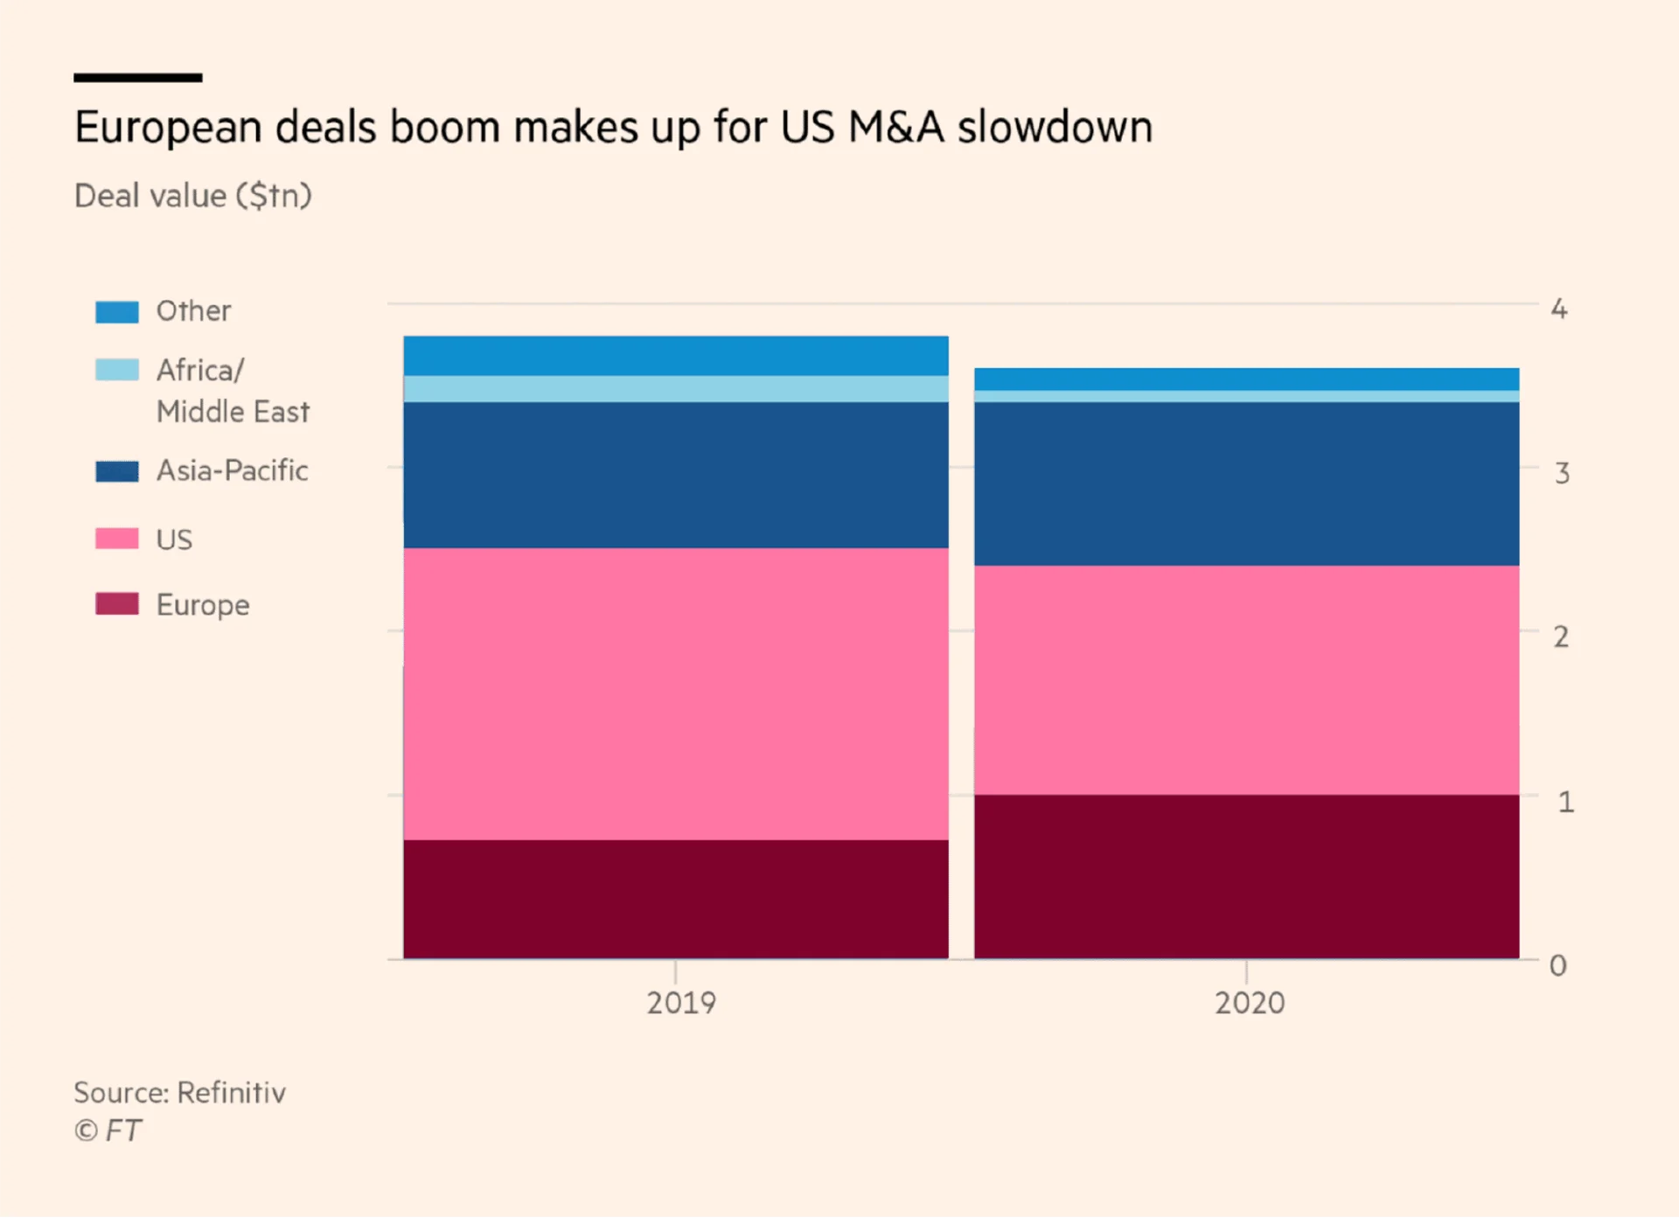

Slide 32
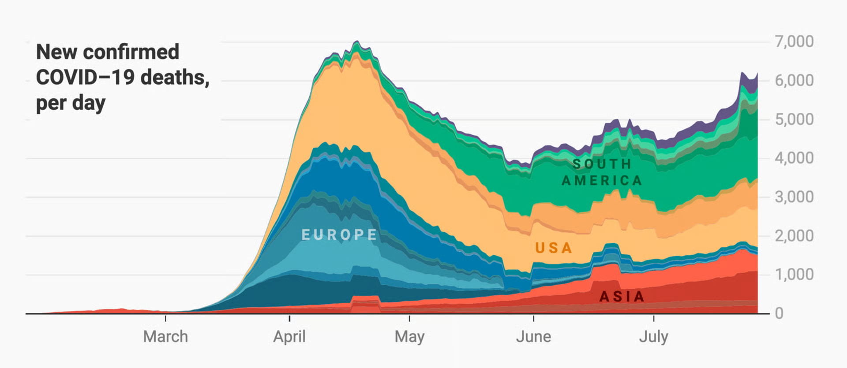

Slide 33
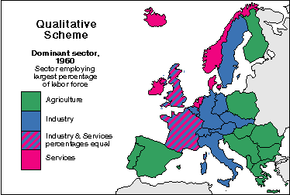

Slide 34
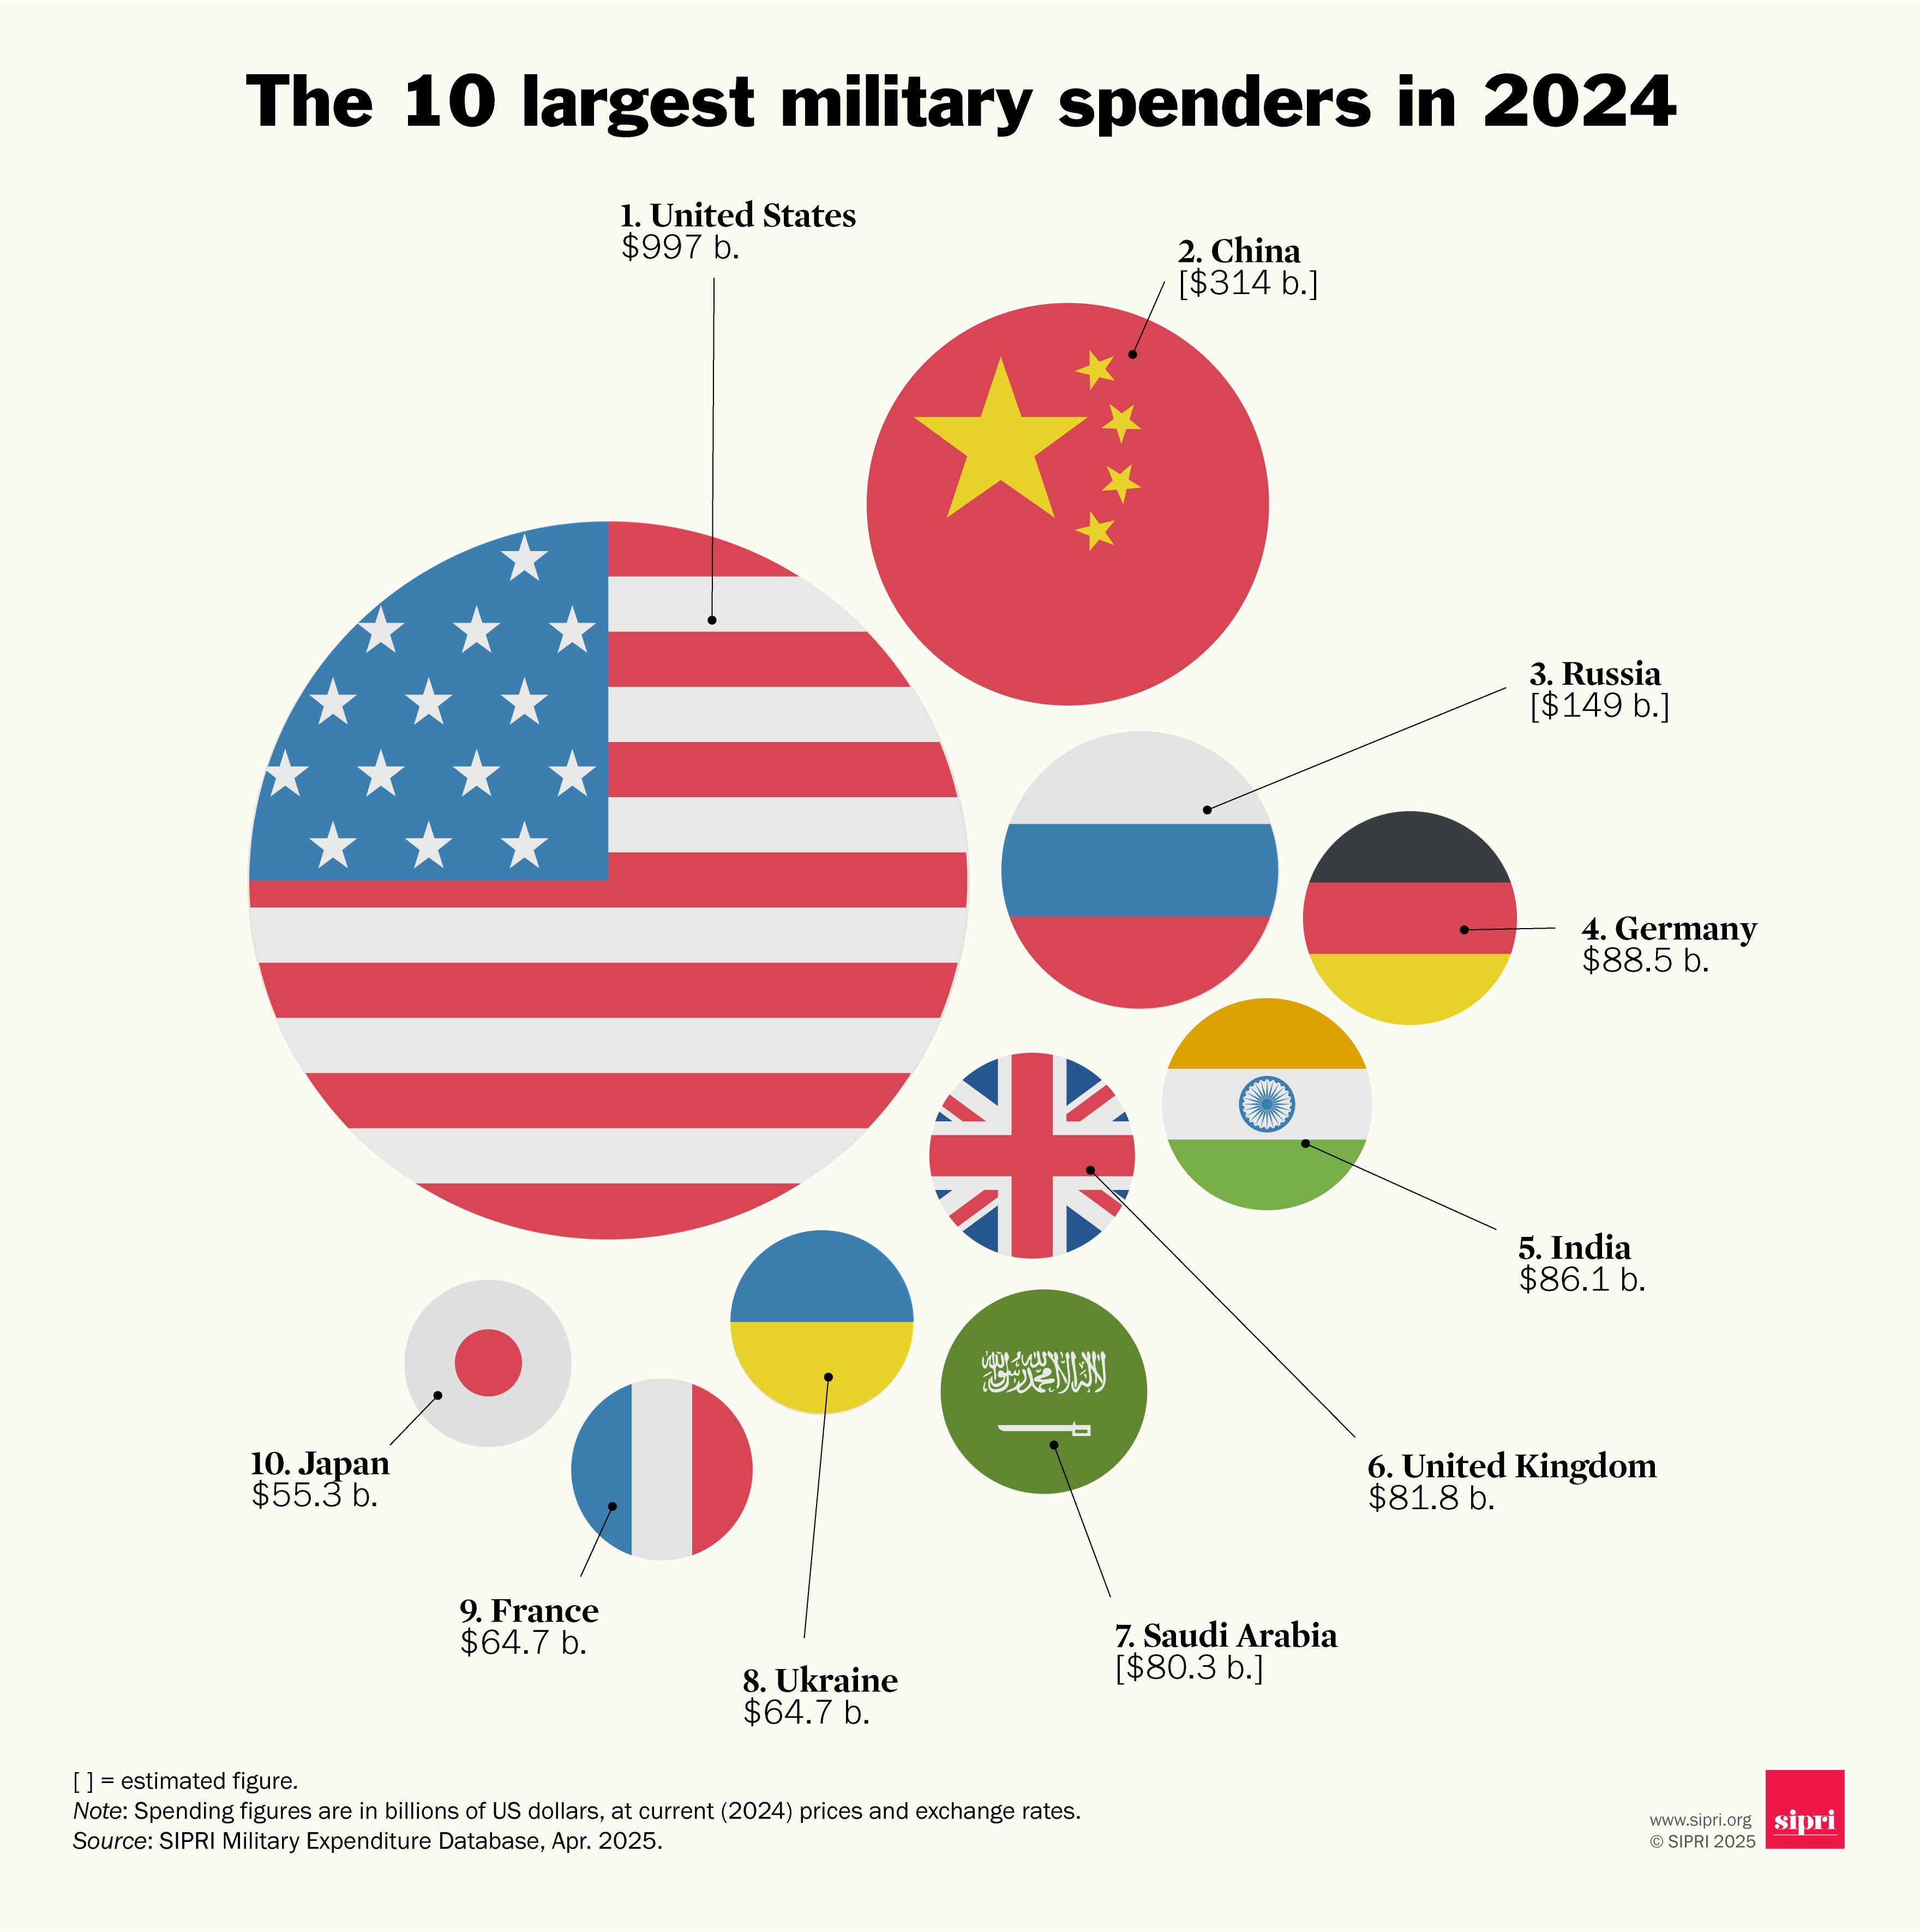

Slide 35
Diverging Palette
The diverging palettes are designed to emphasize the contrast between two diverging segments of the data.
It is especially effective when highlighting deviations from a central value or trend. By utilizing colors that diverge from a midpoint, they help draw attention to both positive and negative variations from the norm.

Slide 36
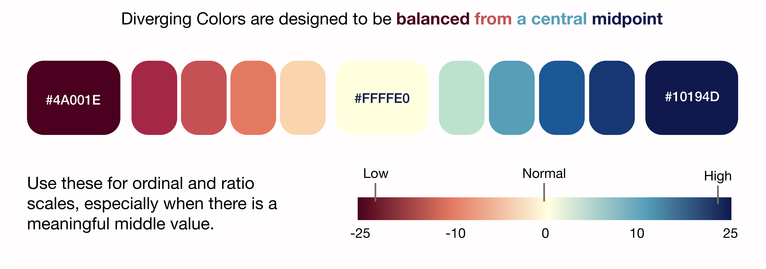

Slide 37
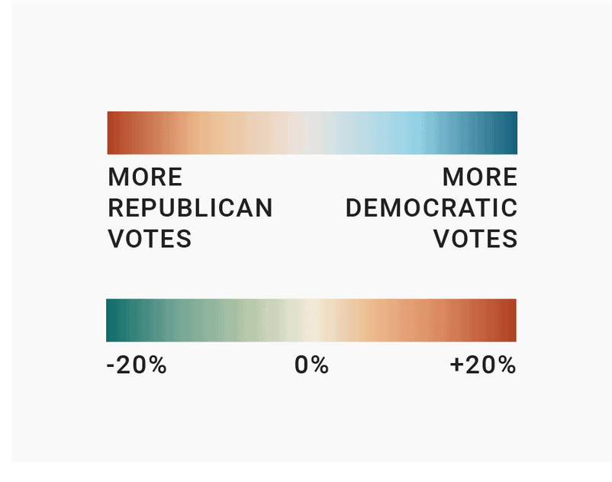

Slide 38
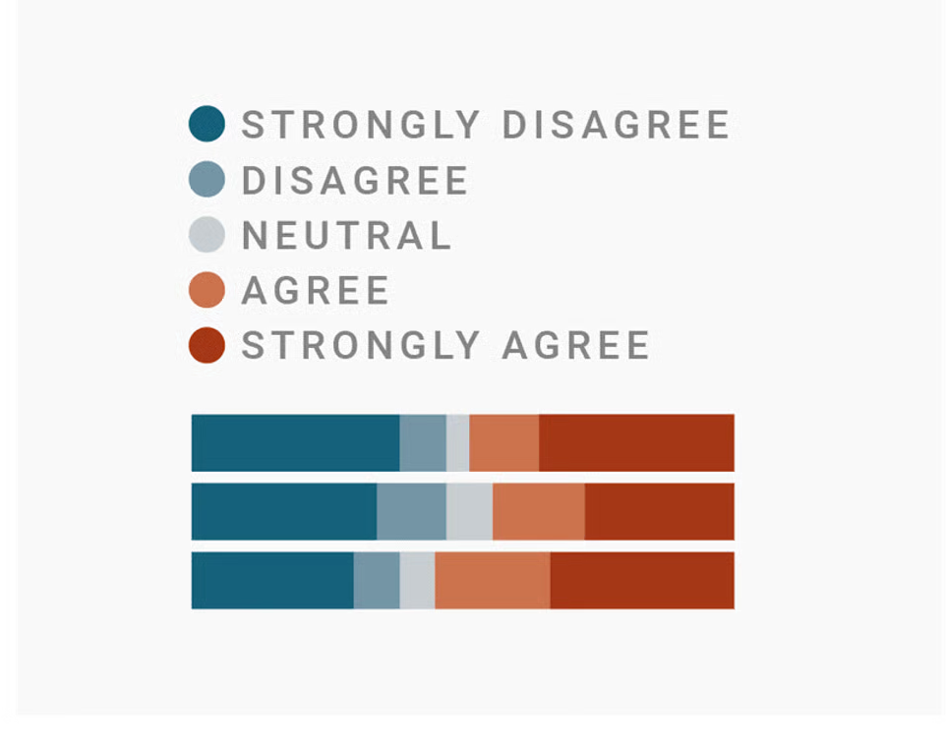

Slide 39
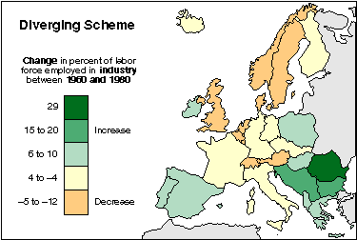
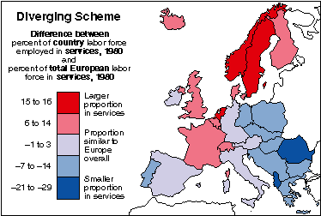

Slide 40
References
https://help.tableau.com/current/blueprint/en-us/bp_why_visual_analytics.htm
https://guides.library.jhu.edu/datavisualization/design
https://www.datawrapper.de/blog/quantitative-vs-qualitative-color-scales
https://web.natur.cuni.cz/~langhamr/lectures/vtfg1/mapinfo_2/barvy/colors.html

